Slide 1
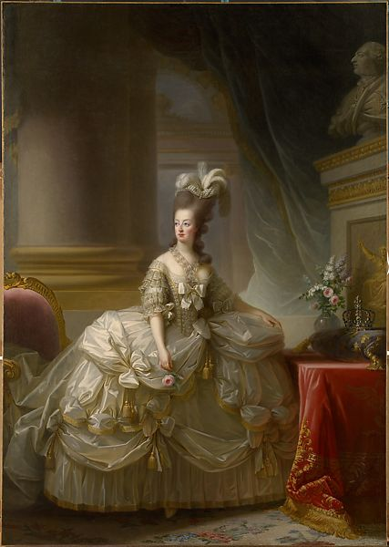
Marie Antoinette in Court Dress Elisabeth Louise Vigée Le Brun 1778

Slide 2
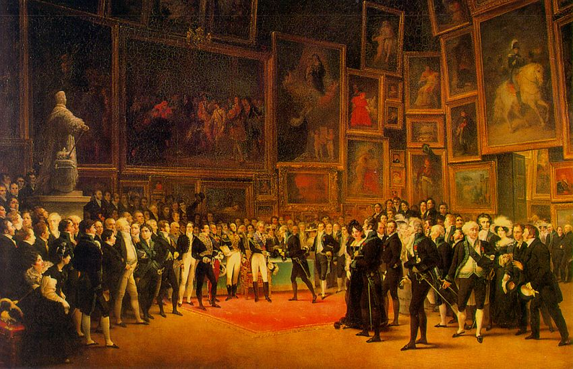
Charles X Distributing Awards to Artists Exhibiting at the Salon of 1824 at the Louvre Francois-Joseph Heim 1827

Slide 3
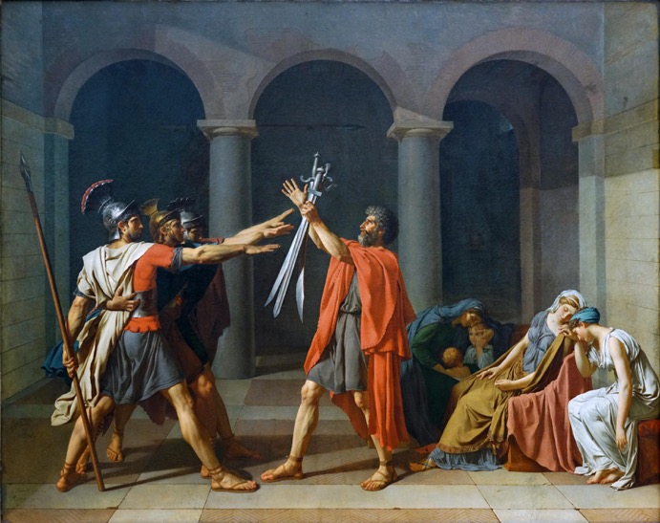
Oath of the Horatii Jacques-Louis David 1784

Slide 4
Neoclassicism

Slide 5
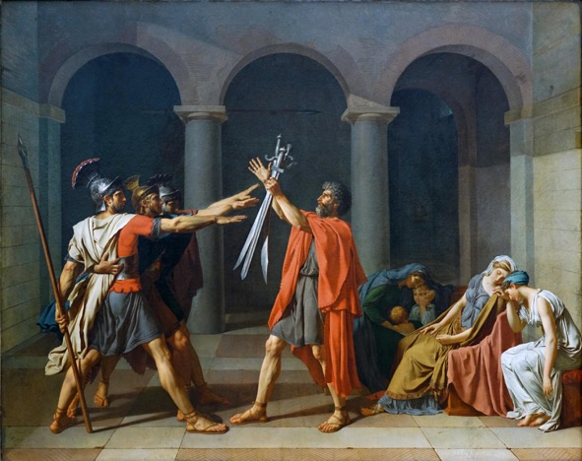
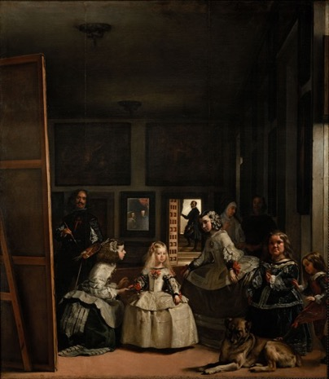
Oath of the Horatii Jaqeus-Louis David 1784
Las Meninas Diego Velazquez 1656

Slide 6
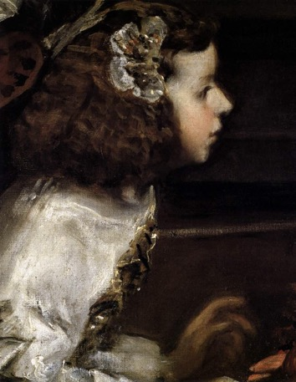
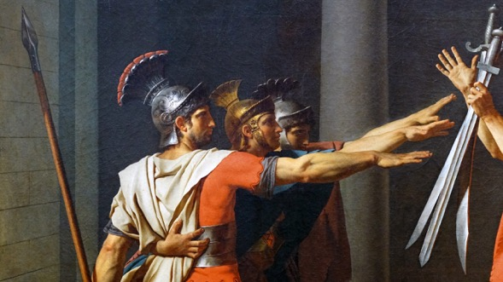
Las Meninas Detail
Oath of the Horatii Detail

