Slide 1
Aztec Empire

Slide 2
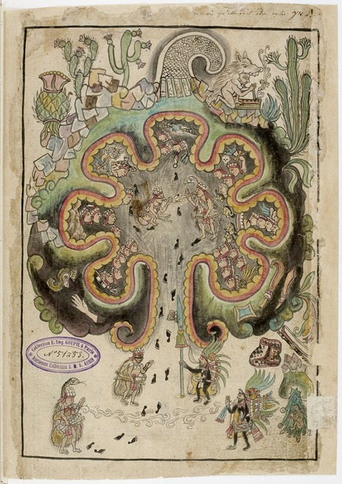
Historia Toteca-Chichimeca 16th Century
Aztlan

Slide 3
Mexican Flag

Slide 4
Ruins of the Templo Mayor 1375-1520 Tenochtitlan

Slide 5
Model of the sacred precinct in Tenochtitlan

Slide 6
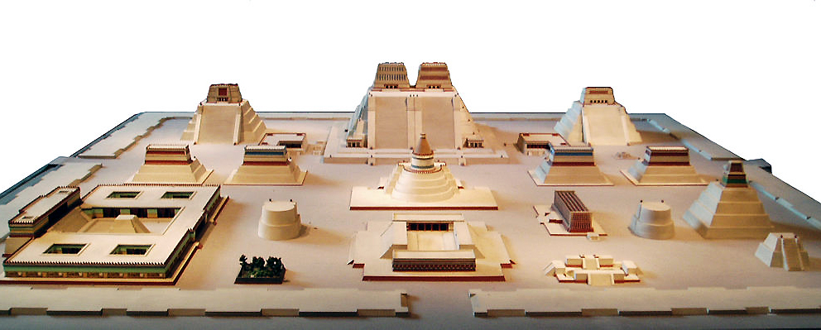
Tlaloc and Huitzilopochtli

Slide 7
Templo Mayor Complex
Ziggurat of Ur 21st Century BCE Mudbrick, faced with Bitumen 210 x 148 x 98 feet Ur, Iraq

Slide 8
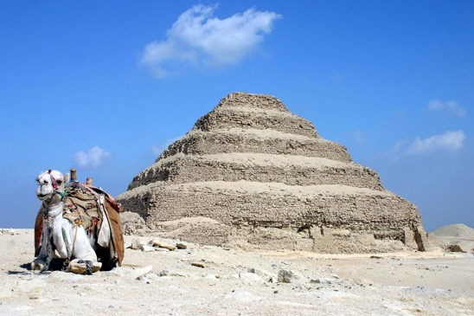
Pyramid of Djoser Imhotep c. 2667-2648 BCE Saqqara, Egypt
Templo Mayor Complex

Slide 9
Chacmool Tlaloc Temple Platform Templo Mayor Tenochtitlan 1325-1519

Slide 10
The Coyolxauhqui Stone c. 1500 Templo Mayor, Tenochtitlan

Slide 11
Coyolxauhqui Stone reconstruction, with possible original colors c. 1500 Templo Mayor Tenochtitlan

Slide 12
Aztec Sun Stone c. 1502-1521 associated with Moctezuma II

Slide 13
Tonatiuh

Slide 14
Codex Mendoza c. 1541-1542 Pigment on Paper

Slide 15
Codex Mendoza c. 1541-1542 Pigment on Paper

Slide 16
Codex Mendoza Detail

