Slide 1
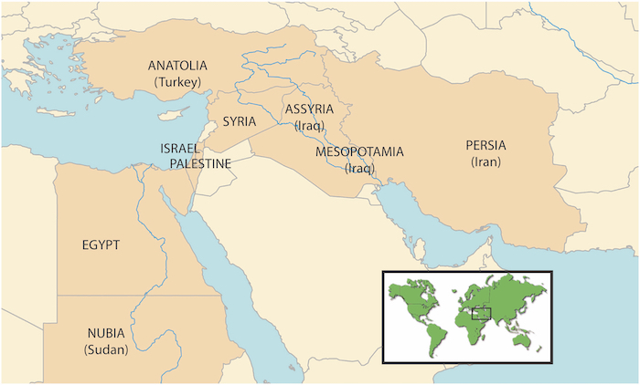
Map of Mesopotamia

Slide 2
Map with Tigris and Euphrates Rivers

Slide 3
Map of the Ancient Near East

Slide 4
Ur

Slide 5
Warka Vase c. 3200-3000 BCE Alabaster 3 feet ½ inches tall Uruk, Sumer (Modern Iraq)

Slide 6
Warka Vase

Slide 7
Warka Vase

Slide 8
Detail of Warka Vase

Slide 9
Detail of Inanna, Warka Vase

Slide 10
Diagram of Warka Vase

Slide 11
Inanna

Slide 12
Detail of Offerings to Inanna, Warka Vase

Slide 13
Register
Standard of Ur
c. 2600 BCE
Royal Cemetery, Ur
Limestone

Slide 14
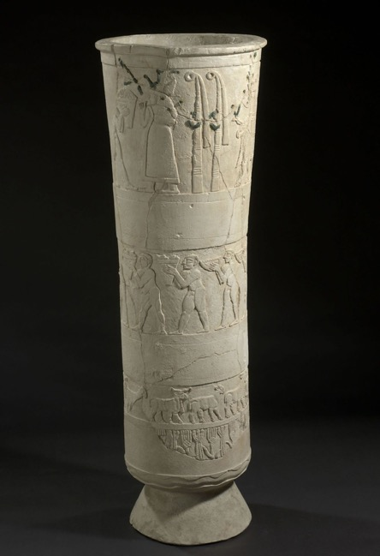
Standard of Ur and Warka Vase

Slide 15
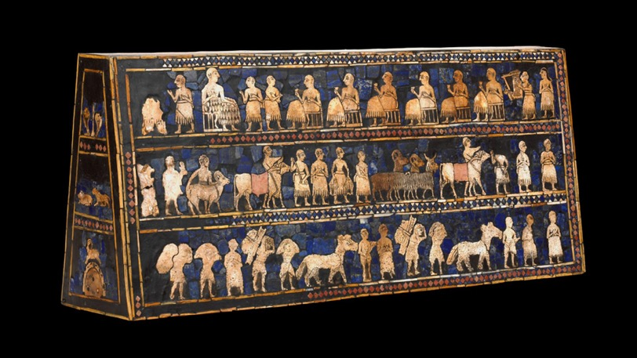
Standard of Ur

Slide 16
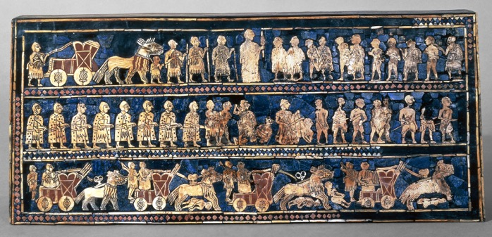
Standard of Ur
War
Peace

Slide 17
Detail of Standard of Ur

Slide 18
Tell Asmar Hoard ca. 2900-2550 BCE Gympsum, Limestone, Alabaster 8.2-28.3 inches tall Eshnunna (modern Tell Asmar), Iraq

Slide 19
Standing Worshipper from Tell Asmar

Slide 20
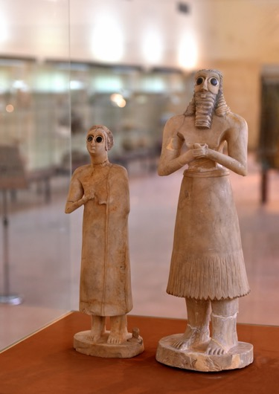
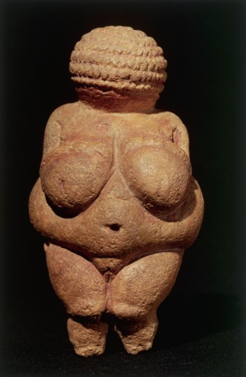
Tell Asmar Hoard
Venus of Willendorf

Slide 21
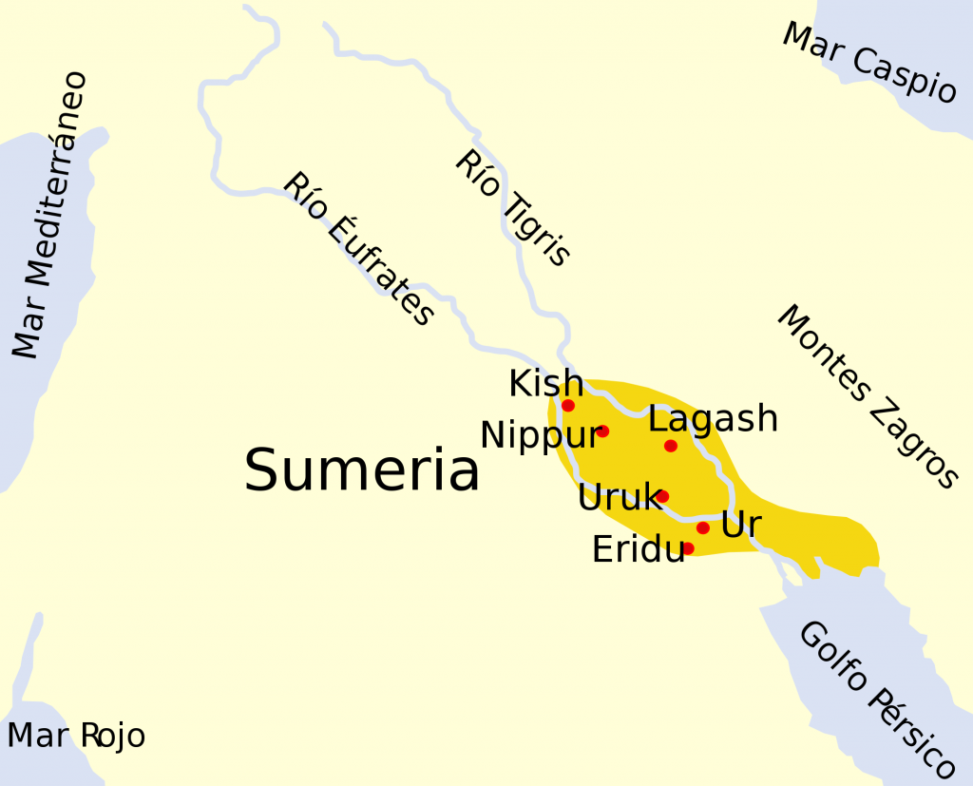
Map of Sumeria

Slide 22
Ziggurat of Ur 21st Century BCE Mudbrick, faced with Bitumen 210 x 148 x 98 feet Ur, Iraq

Slide 23
Ziggurat of Ur

Slide 24
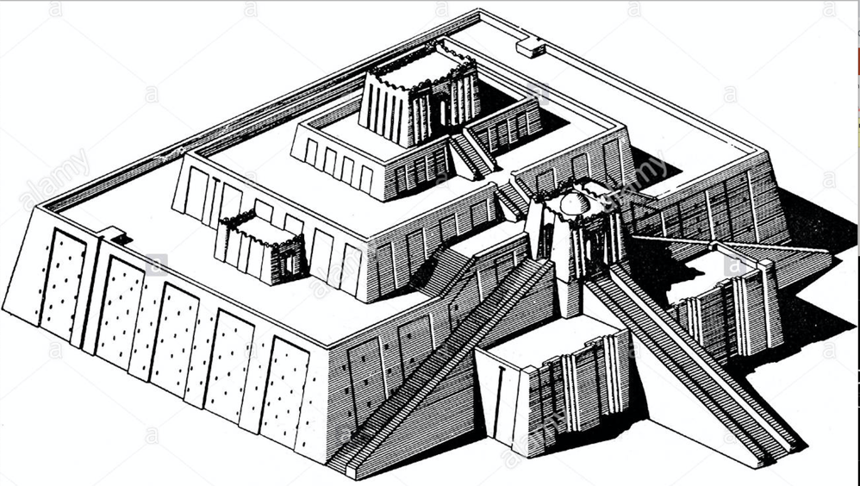
Diagram of Ziggurat of Ur

Slide 25
Ziggurat of Ur, before Restoration

Slide 26
Map of Babylonia

Slide 27
Law Code Stele of Hammurabi 1792-1750 BCE Babylonian Basalt (stone) 7.4 feet tall

Slide 28
Law code Stele of Hammurabi and Venus of Willendorf

Slide 29
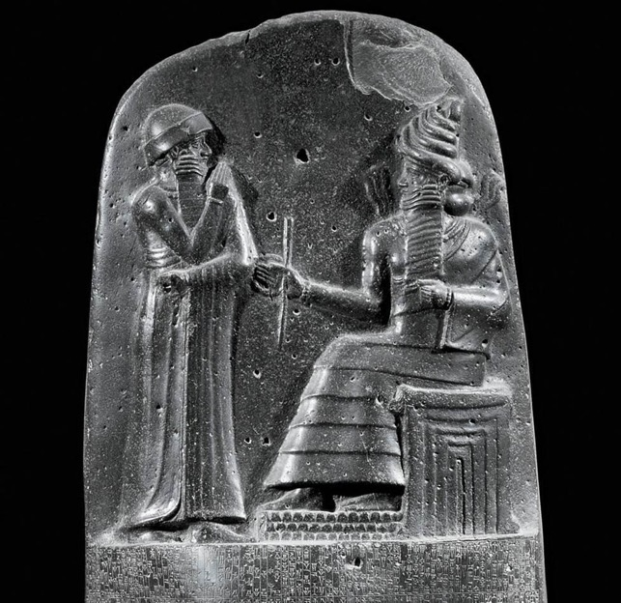
Law code Stele of Hammurabi

Slide 30
laws
Hammurabi
Shamash

