Slide 1
Compare and contrast the given works of art in complete sentences. Use relevant art historical vocab and visual analysis to support your argument. You do not need to include everything you know about each work of art; select which information you include to best support your argument.

Slide 2
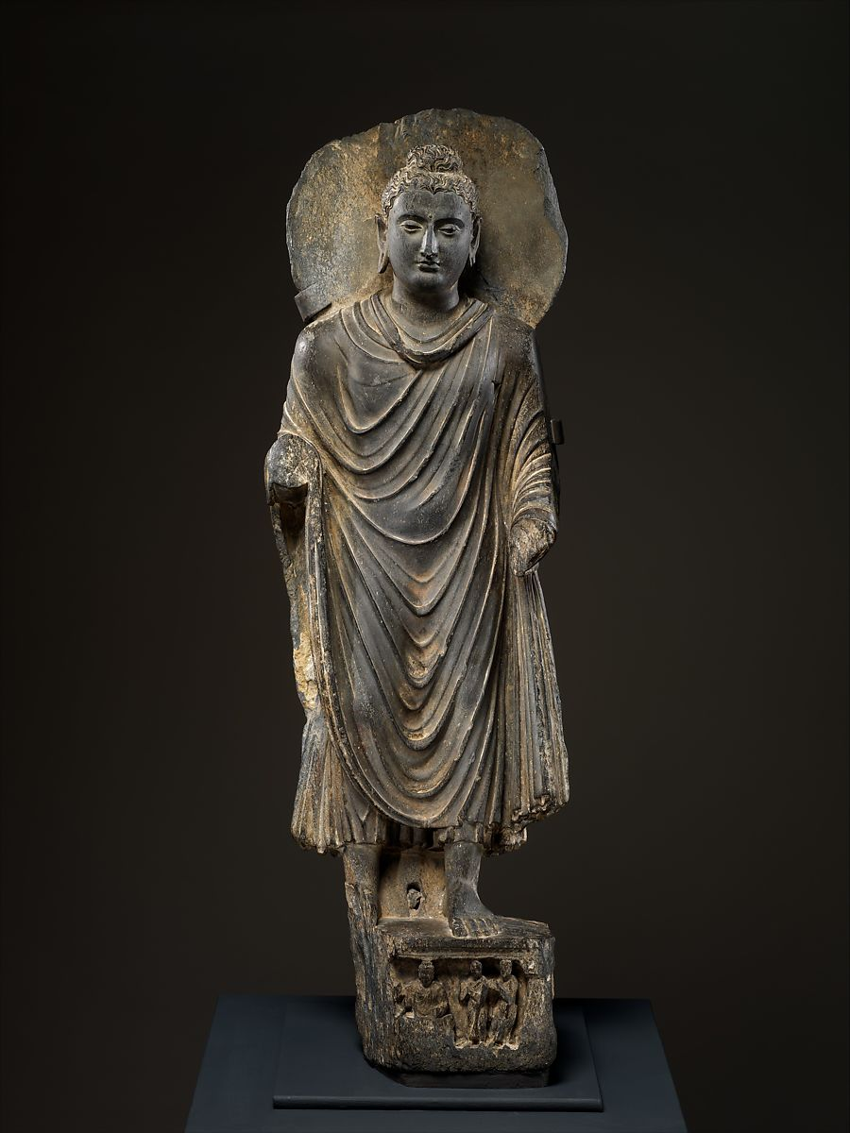
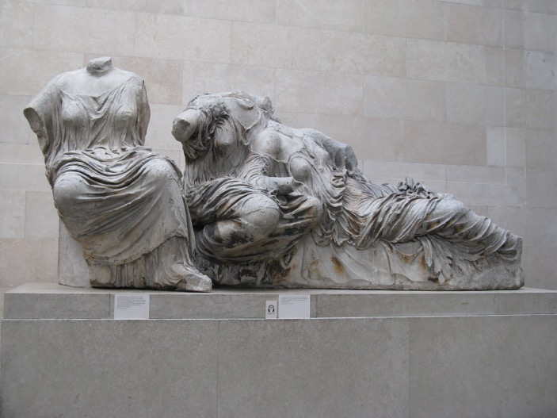
Buddha 3rd Century CE Pakistan
Three Goddesses Phidias c. 448-432 BCE Parthenon, Athens

