Slide 1
General Instructions
Complete the 2 comparisons and 1 long essay and email to me by 3/26/20 at 9:30 AM.
You may use class notes and readings. Please do not consult with anyone about the exam or google answers.
Please complete the exam in one sitting and limit your time to 1 hour 45 minutes.

Slide 2
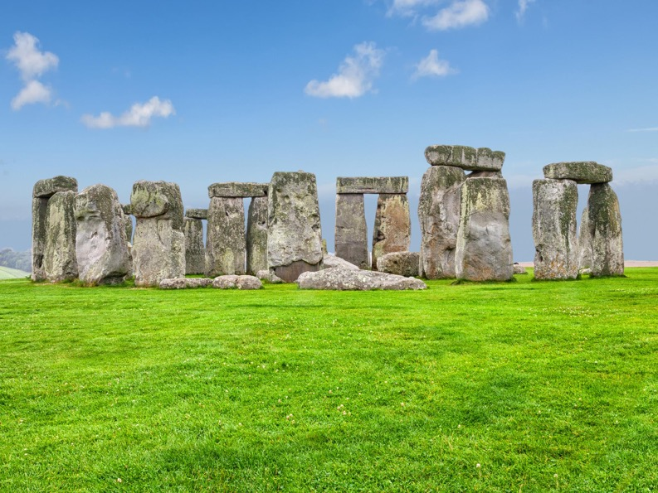
Comparison 1
Stonehenge
Wiltshire, England
Neolithic Era
Basilica of Saint-Denis
Ambulatory
St. Denis, France
Choir completed 1144

Slide 3
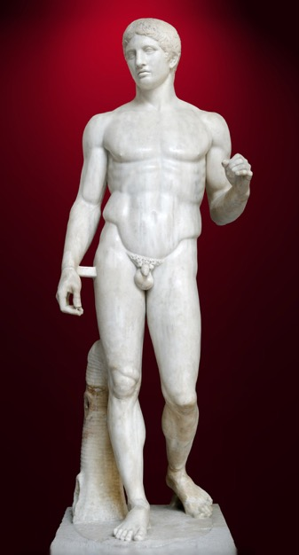
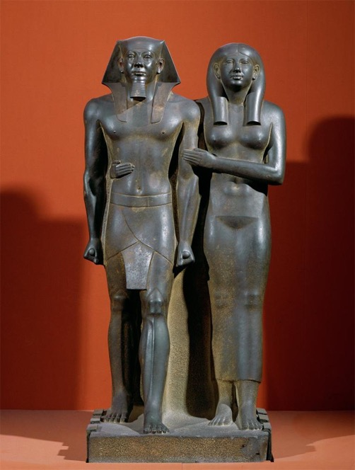
Comparison 2
Mankaure and His Queen
2548-2530 BCE
Egypt
Doryphoros
Polykleitos
Marble after a Bronze original
1st C BCE (c. 440 CE

Slide 4
Essay Option 1 Images
Ziggurat of Ur 21st Century BCE Mudbrick, faced with Bitumen Ur, Iraq
Dome of the Rock Jerusalem 691-92 CE Associated with ’Abd al-Malik

Slide 5
Essay Options: CHOOSE ONE
Essay 1: Different cultures design sacred spaces differently. How do the Dome of the Rock and the Ziggurat at Ur represent the different interests of their patrons? Hint: think about what the buildings look like and how they were used.
Essay 2: Idealism means different things to different people and so the term can be used to describe many different types of art. Pick two works of art that we’ve studied this semester and discuss how they represent idealism. For example, you could compare the Three Goddesses and Gislebertus’ Last Judgement, as we did in class. You may NOT talk about the Three Goddesses, Gislebertus’ Last Judgement, or any of the works from the comparison section of this exam.

