Slide 1
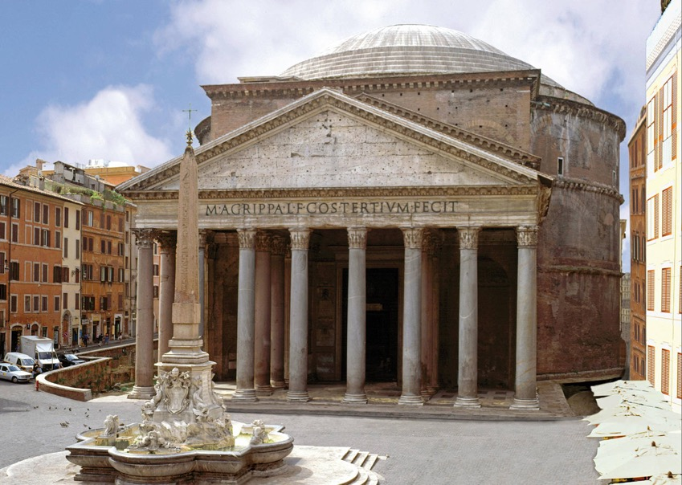
Pantheon 113-125 CE Rome, Italy

Slide 2
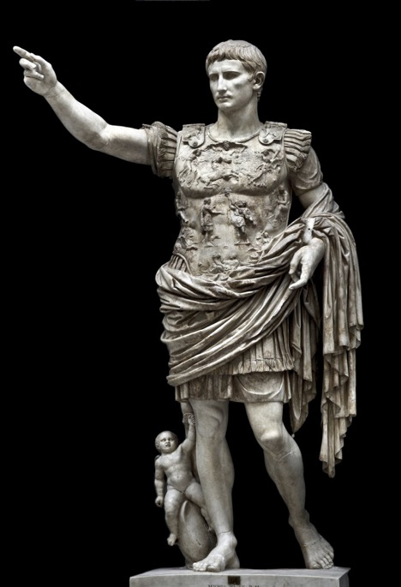
Augustus of Prima Porta Early 1st Century, c. 20 BCE Marble, after a Bronze original H. 6’6’’

Slide 3
Head of a Roman Patrician from Otricoli c. 75-50 BCE Marble

Slide 4
The Parthenon 447-432 BCE (Classical) Athens, Greece Iktinos and Callicrates

Slide 5
Doryphoros Polykleitos Marble after a bronze Original 1st century BCE (original c. 440 BCE)

Slide 6
Marble statue of a kouros (youth) c. 590-580 BCE (archaic) Marble

Slide 7
Seated Buddha Late 6th-early 7th Century CE India

Slide 8
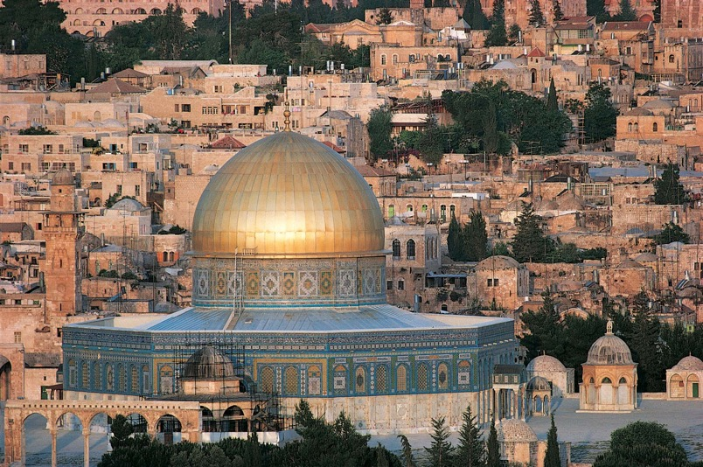
Dome of the Rock Jerusalem 691-92 CE Associated with ’Abd al-Malik

Slide 9
Terracotta Army of Emperor Qin Shi Huang 210-209 BCE China

Slide 10
Great Stupa Sanchi, India 3rd Century BCE

Slide 11
Menkaure and His Queen 2548-2530 BCE Egypt

Slide 12
Akhenaten, Nefertiti and their Children c. 1340 BCE Egypt

Slide 13
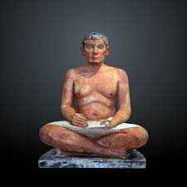
The Seated Scribe
2600s BCE
Egypt

Slide 14
Pyramid of Khufu c. 2580-2560 BCE Egypt

Slide 15
Pyramid of Djoser Imhotep c. 2667-2648 BCE Saqqara, Egypt

Slide 16
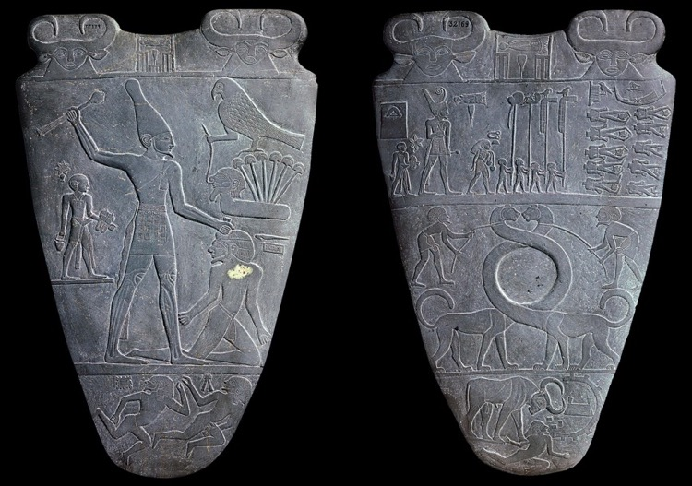
Narmer Palette Egypt c. 3200-3000 BCE

Slide 17
Tell Asmar Hoard ca. 2900-2550 BCE Eshnunna (modern Tell Asmar), Iraq

Slide 18
Ziggurat of Ur 21st Century BCE Mudbrick, faced with Bitumen Ur, Iraq

Slide 19
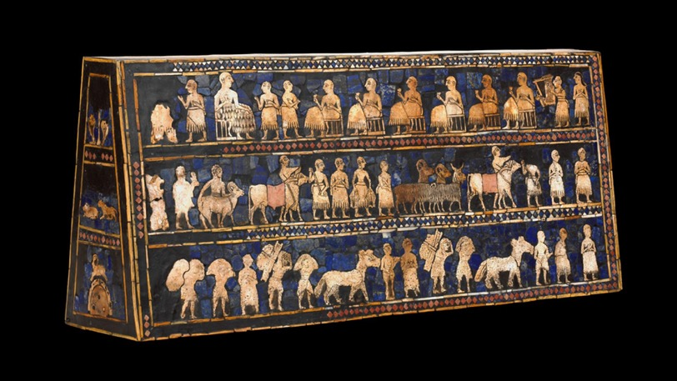
Standard of Ur c. 2600 BCE Royal Cemetery, Ur

Slide 20
Warka Vase c. 3200-3000 BCE Uruk, Sumer (Modern Iraq)

Slide 21
Venus of Willendorf Willendorf, Austria Paleolithic, c. 28,000-25,000 BCE 4.4 inches tall

Slide 22
Hall of Bulls Lascaux, France Paleolithic, c. 17,000-15,000 BCE

Slide 23
Stonehenge Wiltshire, England Neolithic Era

Slide 24
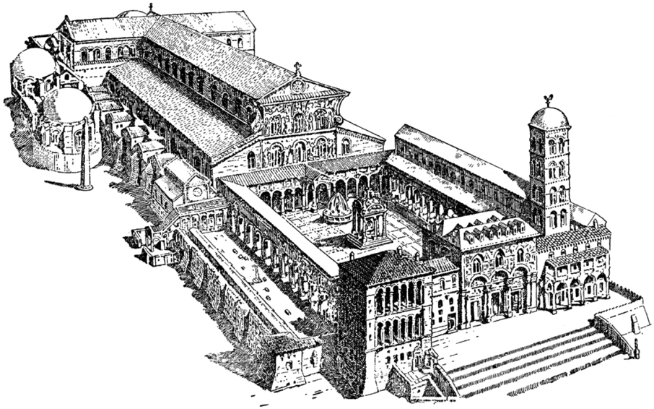
Old Saint Peter’s Basilica Rome, Italy C. 360, destroyed 1405

Slide 25
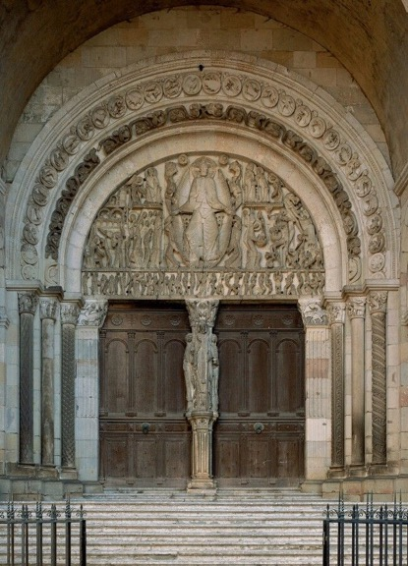
The Last Judgment Gislebertus St. Lazare Cathedral Autun, France c. 1130 CE

Slide 26
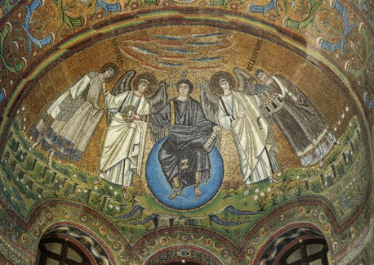
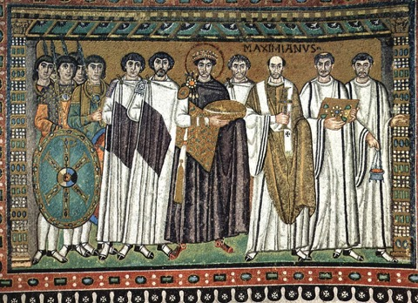
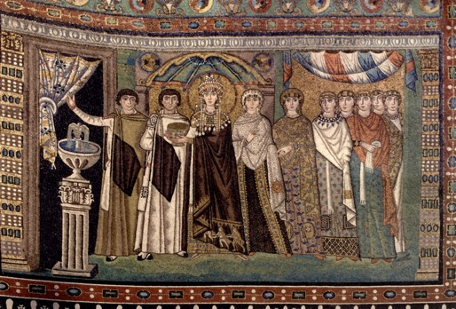
Church of San Vitale Ravenna, Italy c. 547 Christ in Majesty Theodora and her Retinue Justinian and his Retinue Mosaic

Slide 27
Hagia Sophia Isidore of Miletus and Anthemius of Tralles 532-537 CE Constantinople (Istanbul, Turkey)

Slide 28
Virgin and Child between Saints Theodore and George 6th or early 7th Century

Slide 29
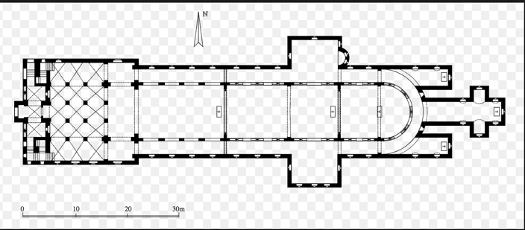
Imperial Abbey of Corvey Germany Consecrated 844 CE

Slide 30
Basilica of Saint-Denis Ambulatory St. Denis, France choir completed 1144

