Slide 1
Lecture Summary
Response Question 1/4 (Slide 3): Compare and contrast the angels. What looks similar and different about them? Which is more naturalistic? Bullet points are fine for this.
Response Question 2/4 (Slide 20): Write one paragraph describing this sculpture using formal analysis.
Response Question 3/4 (Slide 26): Describe this painting in a couple of sentences.
Response Question 4/4 (Slide 27): Please submit any questions you have.

Slide 2
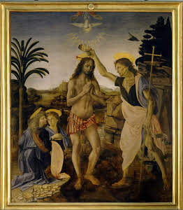
How do you represent the divine?
The Baptism of Christ Andrea del Verrocchio and Leonardo da Vinci 1472-1475 Oil Paint
Notes:
Today we’ll be talking about the High Renaissance, which we defined as a period from 1500-1525 in Italy, particularly Rome, when there was an usually intense amount of artistic production. As Renaissance artists adopted Greco-Roman visual ideals, there was an emphasis on naturalism and the correct portrayal of anatomy. This led to a problem though of how to represent the divine in a naturalistic way.

Slide 3
Leonardo
Verrocchio
Notes:
Look at these two angels. This is a detail of the Baptism of Christ by Andrea del Verrocchio with the help of Leonardo da Vinci. Verrocchio was Leonardo's teacher. Verrocchio painted most of the picture, and Leonardo completed a single angel.
RESPONSE QUESTION 1/4: Compare and contrast the angels. What looks similar and different about them? Which is more naturalistic? Bullet points are fine for this.
To solve the tension of how to depict the divine in human form, artists turned to idealism. Both of these angels are naturalistic and look like figures, but Leonardo’s is more idealized than Verrocchio's. The over-idealization gives the angel an otherworldly quality, so that the anatomy is still correct, as mandated by Renaissance ideals, but seems too perfect for a human figure.
According to stories, Verrocchio was so impressed by Leonardo’s angel that he quit painting.

Slide 4
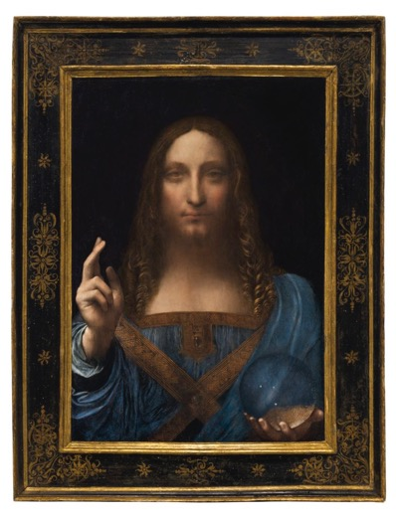
Leonardo da Vinci
Virgin of the Rocks
1483-1486
Oil on Panel
Salvator Mundi
c. 1500
Oil Paint
Sold for $460.3 Million in 2017
Notes:
Leonardo da Vinci was a painter, draftsman, sculptor, inventor, and engineer. He’s very well known as a painter, but less than 20 paintings survive that are verified as his. He’s often been called a “Renaissance Man,” which means someone who does it all and is an expert at many things. He was from Vinci, Florence in Italy, so his name is Leonardo of Vinci.

Slide 5
The Last Supper Leonardo da Vinci 1495-1498
Notes:
One of his most famous paintings is The Last Supper, which depicts the biblical scene where Jesus predicts that one of his apostles will betray him. This scene was particularly common in monastery dining rooms. Leonardo’s Last Supper was in a monastery dining room, and was discovered in an extremely damaged state. The blurriness and haziness of the painting is damage. This painting uses linear perspective.

Slide 6
Jesus
Judas
Notes:
Who can we recognize in this image? Jesus is in the center, and Judas is off to his left. Symmetry is an important element of many Renaissance paintings- here Jesus is in the center, and he divides the image into two halves. Look at the three windows in the background, the center one is directly behind Jesus, flanked by two smaller windows that mirror each other. The image is balanced.

Slide 7
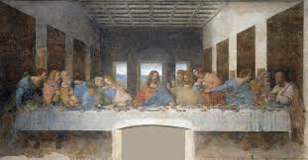
Last Supper Andrea del Castagno 1445-1450
The Last Supper Leonardo da Vinci 1495-1498
Notes:
Leonardo uses linear perspective to create the illusion of depth in his painting. Think about how Leonardo’s last supper compares to Andrea del Castagno’s, which was painted about 50 years earlier. Leonardo’s painting reflects changes in what society looked for in paintings. His colors are more muted and naturalistic, the decoration is less embellished. Perspective is used to show depth. In Andrea del Castagno’s there is perspective, but the image looks very different. The decoration is elaborate (like the colored marble on the walls). Del Castagno’s figures are separated and not speaking to each other, while Leonardo’s are moving and speaking, and so appear more natural.

Slide 8
Mona Lisa Leonardo da Vinci 1503
Notes:
What type of perspective do you see here? In arguably his most famous painting, the Mona Lisa, Leonardo uses atmospheric perspective. The landscape behind the woman gets blurrier and the rivers and trees smaller as they recede into the painting. This painting is a portrait- it shows us a specific person and is a marker of status. We’re not sure exactly who is pictured here, but this woman is likely the wife of a wealthy merchant from Florence, where Leonardo worked. What’s confusing about the painting is that Leonardo never gave it to the patron when it was finished. Instead, he took the painting with him when he went to France to work for King Francis I. We can only guess why Leonardo did this.

Slide 9
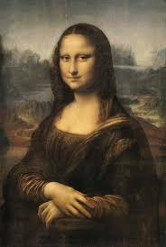
The Duke and Duchess of Urbino Piero della Francesca 1467-1472
Notes:
With Mona Lisa, Leonardo helped change what the typical portrait looked like. Previously, portraits had been in strict profile, like this double portrait of the Duke and Duchess of Urbino, by Piero della Francesca. Leonardo puts his figure in ¾ profile, so that she looks out towards the viewer. This gaze has captivated audiences because it engages with the viewer.
Pay close attention to the colors and lines in these works. In della Francesca’s double portrait, the colors don’t blend together. In Mona Lisa, colors are blended and hazy, which makes the painting seem more naturalistic. This is sfumato- a technique of allowing tones and colors to shade gradually into one another, producing softened outlines of hazy forms.
The shift to a ¾ profile, the use of sfumato, and the atmospheric perspective are all about increasing naturalism.

Slide 10
Portrait of a Young Man at Prayer Hans Memling 1487
Notes:
Leonardo was not the first to abandon the strict profile of earlier portraiture. This portrait by Hans Memling is also in ¾ profile. Unlike Leonardo though, Memling does not use sfumato and the young man does not look out at the viewer, preventing engagement between the figure and the sitter (the person posing for the portrait, in this case the young man at prayer).

Slide 11
ATMOSPHERIC
LINEAR
Notes:
Let’s think about perspective for a moment. Mona Lisa uses atmospheric perspective and The Last Supper uses linear perspective. Both can be used at the same time. There is no linear perspective in Mona Lisa, but can you see any atmospheric perspective in The Last Supper? Look closely at the windows and observe the small, blurry mountains in the background- this is atmospheric perspective in a painting that primarily uses linear perspective.

Slide 12
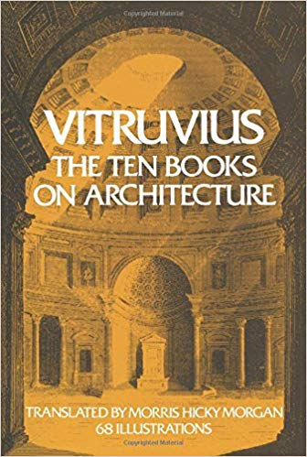
Vitruvian Man Leonardo da Vinci c. 1490 Ink
Notes:
Leonardo is also known for his sketches, like this one, which was found in his copy of the Roman architect Vitruvius’ treatise on architecture. In this sketch, Leonardo shows the ideal proportions of the human body. Leonardo is displaying the same interests that Greco-Roman artists did. Recall Polykleitos’ canon of proportions, or Iktinos and Kallikrates’ use of math and proportions to design the Parthenon. Leonardo is using math to perfect anatomy. Leonardo takes this a step further though and adds modern science. He is known to have observed the human body and experimented with cadavers (which was illegal at the time) to understand how the human body worked so that he could depict it more accurately.

Slide 13
Michelangelo Sistine Chapel 1508-1512
Notes:
This the Sistine Chapel, the Pope’s private chapel, the same chapel where we saw Perugino’s Delivery of the Keys to St. Peter. Today we’re going to look at the ceiling, which was originally blue with stars. The pope asked Michelangelo to redo it with geometric designs and images of the 12 apostles. Michelangelo proposed something else though, and suggested old testament scenes divided by painted architectural elements.

Slide 14
Painted
Notes:
Here is an overview of the whole ceiling. It is entirely painted on a flat surface. All of the architectural elements, like the columns and decorative molding are painted to look 3D. We call this type of art illusionistic- art that creates the illusion of a real object or scene. Michelangelo is trying to trick the viewer into thinking that we’re seeing actual figures and architectural elements, and not looking at a painting, by making the composition so realistic. It has been painted to look like there are columns dividing the space, but the entire ceiling is in fact flat.

Slide 15
Michelangelo The Deluge Sistine Chapel Ceiling 1508-1512
Notes:
Michelangelo painted the ceiling in two phases; from 1508-1510 and 1511-1512. The Deluge is one of the early scenes, which feature complex narratives filled with many small figures. This is a scene of a flood from the Bible, often called Noah’s Ark. We see the ark in the back and figures escaping to dry land in the foreground. Michelangelo is making an effort to fit many narrative elements into the scene.

Slide 16
Michelangelo The Creation of Adam Sistine Chapel Ceiling 1508-1512
Notes:
In 1510 Michelangelo stops working for a year, and when he returns he starts painting images like this one, The Creation of Adam. In the later images, the figures are larger and the focus is on them, not on narratives. He condenses stories into simple images that aren’t concerned with depicting every bit of the story. Instead, the focus is on the figures and how they are depicted. The figures here have more mass and volume, and are over-idealized. Look at Adam’s outstretched arm and observe how his hand is slightly limp- Michelangelo is interested in anatomy and how the body works.

Slide 17
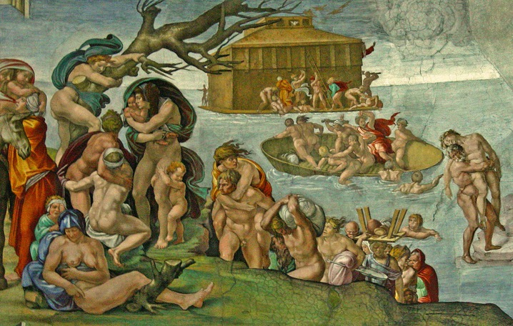
Michelangelo Sibyl Sistine Chapel Ceiling 1508-1512
Michelangelo The Deluge Sistine Chapel Ceiling 1508-1512
Notes:
Here is The Deluge side by side with another later section of the ceiling. Both scenes convey space, but the sibyl has no narrative, while The Deluge does.

Slide 18
Pietà Michelangelo 1498-1499 Marble
Notes:
Michelangelo was also a sculptor and this is one of his works called Pietà. A pietà is a scene of Mary holding the body of the dead Christ, which was very popular in Medieval and Renaissance art. What’s remarkable about Michelangelo’s sculpture is his ability to make marble look like flesh. Look at the way Christ’s body drapes over Mary’s lap; Michelangelo is interested in depicting the human body in stone, and doing so with great naturalism. This is also seen in Mary’s face; Mary is not passive and emotionless, but there is visible sorrow on her face as she mourns her son.

Slide 19
David Michelangelo 1501-1504 Marble 17 feet tall
Notes:
One of Michelangelo’s most famous sculptures is David. This sculpture emphasizes Michelangelo’s desire to depict the human body correctly. In the Renaissance there was a renewed interest in science and Greco-Roman ideals, which resulted in artistic interest in depicting the human body correctly. This means not just making sure the figure looks correct, but understanding how the human body works, so that depictions are correct anatomically.
Here Michelangelo depicts David from the Old Testament story of David and Goliath, in which David defeats a giant, Goliath, that is threatening his people. David does so armed only with a slingshot. What scene is this in the story? Michelangelo gives no clues as to if this is the moment before or after David slays Goliath. Perhaps this is the moment when David first sees Goliath and raises his slingshot in his left hand to his shoulder, and a look of surprise is on his face.
Michelangelo isn’t particularly interested in conveying this narrative; we can recognize the story because the slingshot is an attribute of David, but we don’t see David in his armor, as described in the story, nor is this the most important moment of David slaying Goliath. Goliath isn’t even included! This sculpture is about depicting the human form, not telling the story of David and Goliath.

Slide 20
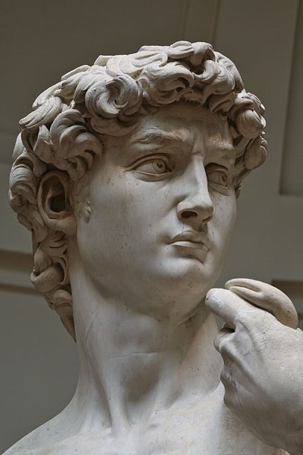
David
Notes:
Take a look at this sculpture in detail. The careful attention to anatomy, like the veins in the hands and the scrunched forehead reveals the intense interest in anatomy and naturalism. This is especially important when we consider the original context of the sculpture. The sculpture is huge, and at 17 feet is much larger than life-size. It was originally supposed to be high up on the outside of the Florence Cathedral, which we saw last class. It is so big so that it would be visible from high up on the building, but those tiny details like the veins on the hands and the widened eyes would not have been visible. These are details that Michelangelo added anyway. People were so impressed by the sculpture that they put it in a square in Florence so that people could see it up close.
RESPONSE QUESTION 2/4: Write one paragraph describing this sculpture using formal analysis.

Slide 21
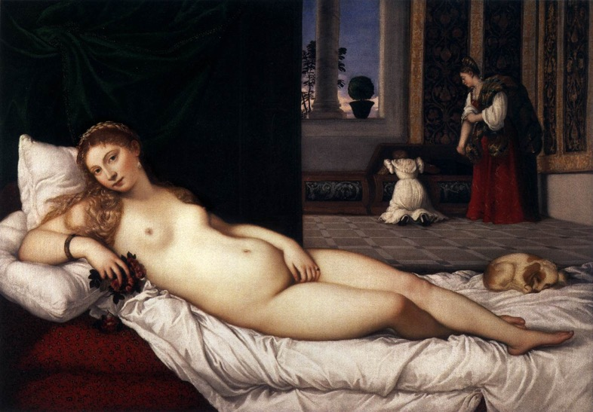
Venus of Urbino Titian 1538 Oil
Notes:
This is Titian’s Venus of Urbino. In the foreground of the painting is a reclining woman and in the background we see 2 other woman by a window. The painting is extremely naturalistic. Look at the skin of the reclining woman, which almost seems to glow because it is so life-like. Titian achieved this effect by using oil paint, which is transparent. He applied 10-15 very thin layers of paint to get very subtle variations of color and to add a life-like depth to the color.

Slide 22
Chiaroscuro- treatment of light and shade in drawing and painting
Notes:
Amplifying the life-like effect of the layers of oil paint is the way that Titian applied the paint. He used a technique called chiaroscuro- the treatment of light and shade in drawing and painting. Look at the woman’s bent knee; her thigh is much lighter than her calf. The use of shadows and highlights adds naturalism to the composition.
The woman’s body is at first glance extremely naturalistic. But she’s not perfect; scholars have pointed out the elongated torso and the very small feet. Titian has given the impression of perfection, but hasn’t idealized anatomy like Michelangelo did.

Slide 23
The Reclining Nude
Medici Venus
Notes:
Titian has positioned this figure in a very particular pose, called the reclining nude, which we’ve seen it before. The reclining nude recalls the Venus Pudica, but she’s lying down now instead of standing.

Slide 24
Dresden Venus Giorgione and Titian 1510 Oil on Canvas
Notes:
The reclining nude was very popular in the Renaissance, and Titian was not the first to use it. Here we have the so-called Dresden Venus, because it is in Dresden, painted by Titian’s teacher Giorgione, with Titian’s help.

Slide 25
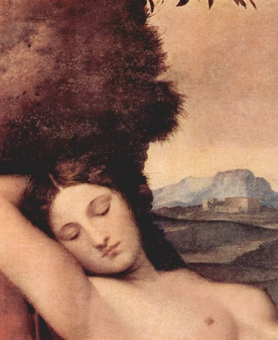
Venus of Urbino
Dresden Venus
Notes:
What’s different about the Dresden Venus and the Venus of Urbino? The Dresden Venus is outside and her eyes are closed. Why is this important? We need a little bit more historical context about the Venus of Urbino to understand what is so shocking about these slight changes.
First, neither Titian nor Giorgione have depicted the Greco-Roman goddess of love. At this period, the trend of naming nudes “Venus” develops because nudity wasn’t acceptable in this society. Calling the figure “Venus” makes the nudity ok because it associates the figure with the Greco-Roman goddess, and not with a real woman. The outside setting and closed eyes add to this; no woman at the time would have been lying naked outside. Think back to Botticelli’s Birth of Venus. The outdoor setting emphasizes that this isn’t a specific person. The closed eyes emphasize that she is not looking at the viewer or realizes that she is being seen, and so removes any erotic undertones of the painting.
In the Venus of Urbino though, she is looking at us and is inside. The open eyes suggest she knows she is being watched (painted) and is not shying away from this gaze, but is returning it. Furthermore, the indoor setting looks like a Renaissance room; this isn’t a mythological figure, but a Renaissance woman. The title Venus allows this nudity, but the open eyes and indoor setting subverts societal expectations.
The major question about the painting is who is this? There are two leading theories. The painting may have been commissioned by the Duke of Urbino to celebrate his marriage to the painted woman. Or, perhaps the painting wasn’t commissioned and features a courtesan, and was later purchased by the Duke. Either way, this painting is not about the unaware beauty of the idealized mythological Venus, but is a study of beauty that uses the name “Venus” to make the nudity socially acceptable.

Slide 26
The Hunters in the Snow Pieter Bruegel the Elder 1564 Oil on Panel
GENRE
SERIES
Notes:
We’re going to jump now to a Northern Renaissance painting, so a painting not from Italy. This painting was painted in the Netherlands by Pieter Bruegel the Elder in 1564.
RESPONSE QUESTION 3/4: Describe this painting in a couple of sentences.
This is a winter scene of peasant life. So far, we’ve seen mostly images of rulers and religious figures, but Bruegel is giving us a glimpse into what life was like for the lower classes. This painting was part of a series- multiple works of art that are made together as part of a unified group. This was a series of four depicting scenes of the four seasons. This is a genre painting- a scene of daily life. We have to be careful with this term ”genre.” In art history it refers to any scene of daily life. It is not used to describe different types of art, like genre could be used to describe different styles of music. For example, the Dresden Venus is not a genre painting, nor is The Last Supper. Portraits and religious scenes are not genre paintings.
This painting doesn’t look like the ones we’ve scene; the focus is more on landscape than on the figures. What’s Renaissance about it though? Notice that there is clear interest in the depiction of space and Bruegel uses atmospheric perspective. There is less interest in anatomy than we’ve seen in other Renaissance works.

Slide 27
Madonna with the Long Neck Parmigianino 1534-1535
Mannerism
Self-portrait in a Convex Mirror
Parmigianino
1524
Notes:
Towards the end of the Renaissance a new style develops called Mannerism, which was popular from about 1520-1600 (so it did overlap with the Renaissance a bit). Mannerist artists weren’t interested in naturalism, but wanted to distort forms for more complex compositions. While the Renaissance prioritized balance and symmetry, Mannerist paintings feel unstable. They have elongated figures and vibrant colors.
These are two typically Mannerist paintings.
Madonna with the Long Neck exemplifies the elongated bodies and instability of Mannerist painting. Her neck is too long; Parmigianino was not interested in depicting “correct” anatomy, but elongated his figures to create curving forms. Furthermore, there is no balance to this painting. It seems as if this grouping is about to fall over; look at the elongated Christ child as he seems to fall off Mary’s lap. This instability is typical of Mannerist paintings.
Self-portrait in a Convex Mirror exemplifies the complexity of painting that Mannerist artist were interested in. Just like in the Arnolfini Wedding Portrait, where Jan van Eyck painted a mirror to show how he could depict space, Parmigianino is interested in how to depict space, but he takes this a step further. Look at how big the figures hand is compared to the head. Parmigianino is observing how reflections work and is depicting that accurately, but is particularly interested in the distortion of the figure caused by the reflection, and exaggerates it.
RESPONSE QUESTION 4/4: Please submit any questions you have.

