Slide 1
Summary
RESPONSE QUESTION 1/4 (slide 6): look at one of these paintings for a little while. If you can, zoom in and look closely at the application of the paint. Appreciate the colors. Do these evoke any particular emotion? There are no wrong answers.
RESPONSE QUESTION 2/4 (slide 17): Describe the screenprint of Marilyn Monroe.
RESPONSE QUESTION 3/4 (slide 19): Compare and contrast these 2 paintings in a paragraph. Work off your description from response question 3.
RESPONSE QUESTION 4/4 (slide 19): Submit any questions you may have.
Notes:
RESPONSE QUESTION 1/4 (slide 6): look at one of these paintings for a little while. If you can, zoom in and look closely at the application of the paint. Appreciate the colors. Do these evoke any particular emotion? There are no wrong answers.
RESPONSE QUESTION 2/4 (slide 17): Describe the screenprint of Marilyn Monroe.
RESPONSE QUESTION 3/4 (slide 19): Compare and contrast these 2 paintings in a paragraph. Work off your description from response question 3.
RESPONSE QUESTION 4/4 (slide 19): Submit any questions you may have.

Slide 2
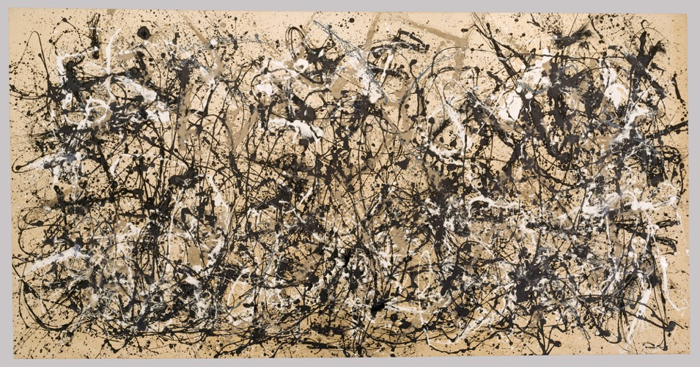
Abstract Expressionism
Autumn Rhythm (Number 30)
Jackson Pollock
1950
Enamel on canvas
Notes:
We’re making a bit of a jump in time towards the late 20th century for our last class with new material. We’ll start with a movement called Abstract Expressionism, which emerges after World War II. Coming out of the war, art tended to be very emotionally charged. Europe was decimated and many people, artists in particular, moved to New York City, which became the new “center” of the art world. Abstract Expressionism started in New York City as a response to the war.

Slide 3
“We felt the moral crisis of a world in shambles, a world destroyed by a great depression and a fierce World War, and it was impossible at that time to paint the kind of paintings that we were doing – flower, reclining nudes, and people playing the cello.” – Barnett Newman
Notes:
One important important Abstract Expressionist, Barnett Newman, said “We felt the moral crisis of a world in shambles, a world destroyed by a great depression and a fierce World War, and it was impossible at that time to paint the kind of paintings that we were doing – flower, reclining nudes, and people playing the cello.”
Newman is saying the type of art that was getting made seemed almost silly in the face of this moral crisis. After the death and suffering of the Great Depression and the 2nd World War, artists had to change how they thought about and made art. Artists incorporated a lot of existentialist philosophies into their art, thinking about the role of the individual unconscious (in away very different than how the Surrealists thought about the subconscious) and how actions give life meaning. Artists working in very distinct individual styles were united by an emotional interest in art. In terms of painting, Abstract Expressionist works are typically large scale abstract paintings that show the artist’s process and are not representational or illusionistic.

Slide 4
Onement, I Barnett Newman 1948 Oil on canvas and oil on masking tape on canvas 27 ¼ x 16 1 /4 inches
Notes:
Let’s start with Barnett Newman, who was a color field painter. Color field painters are a subset of abstract expressionists that use blocks of color to create their works. Newman uses what he calls a “zip” which is the line of color in the middle of the painting.

Slide 5
Onement I, detail
Notes:
At first, when making his paintings Newman would lay masking tape down in the center of the canvas where he wanted the line, would paint over the canvas and then remove the tape, and the zip would have very straight edges. But for this painting, Onement I, he left the tape and painted the brighter red line over the tape, which you can see an outline of behind the dark red if you look very closely.
This zip may not seem like a big deal, but Newman thought this zip was incredibly significant. What did this line mean? There are many theories on this, but one thing about the zip is that it is very vertical. When people stand in front of this painting they tend to stand right in front of the zip, centering themselves around it. The zip becomes almost like a figure, a reflection of the viewer in the painting. This figure is completely abstract, it doesn’t look like a figure, but in the way that it dictates how people interact with it, there seems to be a communication between the viewer and the vertical zip.

Slide 6
No. 61 (Rust and Blue) Mark Rothko 1953 Oil on canvas
No. 46
Mark Rothko
1957
Oil on canvas
Untitled (Black and Gray)
Mark Rothko
1970
Acrylic on canvas
Notes:
Mark Rothko is another color field painter, but a very different one than Newman. Color field painting might at first not seem to have intense emotion.
RESPONSE QUESTION 1/4: look at one of these paintings for a little while. If you can, zoom in and look closely at the application of the paint. Appreciate the colors. Do these evoke any particular emotion? There are no wrong answers.
Rothko’s paintings are made through the layering of paint. He uses extremely thin layers so that there is a lot of very subtle variation in tones. Think back to Titian, when we talked about his layered application of oil paint that led to a vibrancy and translucency in his colors. Something similar is happening with Rothko. This creates a depth in the surface even though at first the paintings can seem a bit flat.
This sort of unconscious emotion- there is not representation or symbolism of sadness or joy, etc.- is related to the emotions that artists wanted to explore after the war.

Slide 7
Autumn Rhythm (Number 30) Jackson Pollock 1950 Enamel on canvas
Notes:
Jackson Pollock was also an Abstract Expressionist; he was part of a subset of painters called Action Painters. Action painters show their process in the work; action painting is all about process over the final product, which is premeditated.
Autumn Rhythm is a good example of action painting. It’s an all over drip painting. All over because it continues off the canvas. Drip because of how Pollock applied the paint. Pollock would stand over the canvas which he lied flat on the floor and he would fling around a paint-soaked stick letting the paint fall where it did. This is the drip. As paint was flung it went everywhere, even landing off the canvas. This is the all over. Pollock would even walked on his canvas as he painted, and some of his works have his footprints in them. Now this image of Pollock haphazardly flinging paint is a bit misleading; he decided what colors to use, what area of the canvas to stand over at each moment, how much paint to apply, etc. But, the painting shows us the process in which it was made. And it seems to reveal something unconscious about the artist and the viewer. Perhaps this feels angry or urgent, with its fast paint marks. By focusing on process there is the idea that Pollock is letting his unconscious make the painting.

Slide 8
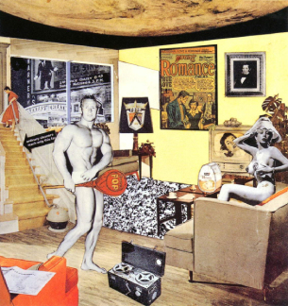
Pop Art
Just what is it that makes today’s homes so different, so appealing?
Richard Hamilton
1956
Collage
Notes:
Around the same time that Pop Art was emerging in New York City, something else was happening in Europe. America had an economic boom after the war, which had largely not been fought on American soil. The Pearl Harbor bombing was the main attack on the US, but the majority of the war had been fought overseas. So, the landscapes and economies of Europe and Asia are very different after the war. In post-WWII Britain for example, there was extreme economic hardship. Artists in England looked at images of American art and saw the lifestyles of the economic boom. Early Pop Art emerged in England to critique American excess.
This Richard Hamilton work is typically considered the first work of Pop Art. He collages magazine clippings to show a well-off American home and satire consumerism. The material adds to this; magazines were filled with ads, as it was this period that saw the rise of advertising and television and so images of every day life were a lot more visible. In America there was a rise in consumer culture; people have more leisure time and more disposable income, so they’re buying things. With new technologies, this consumerism leads to mass production.
Pop artists take images from popular culture and celebrity culture and use them to critique this mass consumption, and to cerate a new kind of painting. A lot of art we’ve seen has been about universal truths, like De Stijl, or the emotions of the artist, like Abstract Expressionism. Pop Art though is about this moment in American consumer culture.

Slide 9
Drowning Girl Roy Lichtenstein 1963 Oil and synthetic polymer paint on canvas
Notes:
Just like Hamilton used magazine clippings and advertising to comment on consumer culture, Roy Lichtenstein also looked at print media. He used comic books- taking scenes that look like comics to poke fun at consumerism and American celebrity culture.
The comics are really a parody of mass printed culture through exaggeration and melodrama. Look at the caption here, “I don’t care! I’d rather sink than call Brad for help!” Lichtenstein paints a lot of scenes of dramatic love, like here where the woman would rather drown than call Brad, who is implied to be her husband, boyfriend, or lover for help. We don’t know what happened between them, but we get the sense of dramatic emotion.

Slide 10
Drowning Girl, Detail
Notes:
Looking closely, you may notice that it looks like her skin is made of a lot of little dots.

Slide 11
Ben-Day Dots
Notes:
These are called Ben-Day dots, small colored dots that are placed at varying distances. Through overlap and space between them, the different dots can create variations in color using only four colors of dots- cyan, magenta, yellow, and black. Ben-Day dots were used in comic book production in the 1950s because it was cheaper to print only 4 colors. Lichtenstein uses this commercial printing technique in painting. Like collage in Cubism or ready-mades in Dada, the use of materials and techniques not typically used in a fine art context is an important change in how artists were thinking about art in the modern period.

Slide 12
Rouen Cathedral, Set 3 Roy Lichtenstein 1968-69 Oil and Magna on five canvas panels
Notes:
While Pop Art may seem like a radical break from the art we’ve looked at in the past, and it in many ways it was, artists still did look to the past. Do these paintings look familiar?

Slide 13
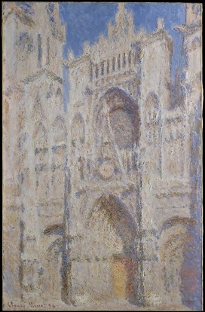
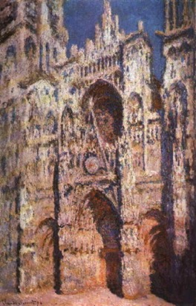
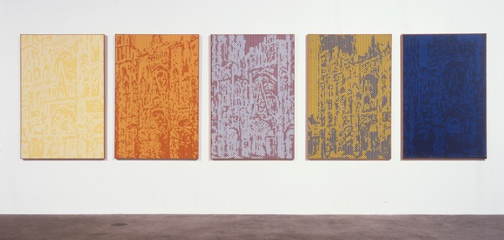
Rouen Cathedral, Full Sunlight 1894
Rouen Cathedral: The Portal (Sunlight) 1894
Rouen Cathedral, Set 3 Roy Lichtenstein 1968-69
Notes:
Lichtenstein is making his own version of Monet’s Rouen Cathedral series. Think back to our class on Impressionism, when we discussed Monet creating images over and over again of the same scenes in different lighting. With five panels Lichtenstein does the same thinking, creating a sense of changing light through different colors, still using Ben-Day dots.
RESPONSE QUESTION 2/3: Compare these paintings in a few sentences or a paragraph. Think about technique. What effects do the brushstrokes have, etc?

Slide 14
Campbell’s Soup Cans Andy Warhol 1962 Acrylic with metallic enamel paint on canvas, 32 panels
Notes:
Another Pop artist was Andy Warhol, who originally trained as a commercial artist. A commercial artist makes art to promote and sell goods or services, like a graphic designer. Warhol said that “I don’t think art should be only for the select few. It should be for the mass of the American people.” Warhol dedicated himself to making art, using famous objects and people- like commercial goods and celebrity portraits- that would be recognizable and understandable to a large American audience. His imagery was representational, like the Campbell’s soup can. At the time, most artists were making abstract works, like abstract expressionist paintings, so Warhol was doing something very different.

Slide 15
Campbell’s Soup Cans Tomato Soup Detail Andy Warhol
Notes:
Why the soup can? Campbell’s was an incredibly well known brand when Warhol decided to use the image. He used it as an emblem for consumer culture and mass production. He made 32 can paintings as there were 32 types of Campbell’s soup at the time. At the gallery, the paintings were lined up on shelves like cans of soup at a grocery store. Each painting was sold individually. However, after selling a few paintings, the gallery owner decided the paintings worked better as a unit, and so he bought back the sold paintings and sold them as a group, with the 32 paintings arranged as a grid.
Why might he have thought the paintings were more powerful as a group? The soup cans use serial imagery- the same image over and over again. By keeping the paintings together as a group, you see the image over and over, amplifying the effect of the image. As Warhol was thinking about mass production, it’s important that the painting consists of 32 cans. With the viewer encountering the 32 cans of soup at once, the image feels mass produced.
The technique adds to this mass produced, commercially made effect. Warhol carefully made the image so that it resembled the actual advertisements put out by Campbell’s at the time. If you look carefully there are slight variations in the fleur de lis images at the bottom of the can (the little yellow lilies). The can looks printed and mass produced, but these little variations show the hand of the artist.

Slide 16
https://www.youtube.com/watch?v=BvLlTMczUDg
Notes:
After completing Campbell’s Soup Cans, Warhol further explored the idea of commercial printing in his art making. He started using a technique called silk screening, a type of printmaking. Watch the video above for a short overview on this process.

Slide 17
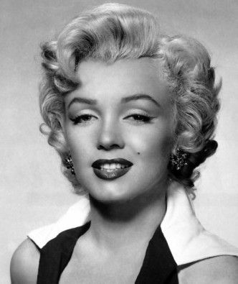
Marilyn Monroe Andy Warhol 1967 Portfolio of 10 screenprints
Marilyn Monroe Niagara 1953
Notes:
Silk screening, which is the technique Warhol used when making this portrait of Marilyn Monroe allowed Warhol to use blocks of color to create the sense that this work is not handmade. This is one of 10 screenprints in a portfolio with Marilyn Monroe, who was a famous actress that Warhol begin depicting after she died in 1962. Her death was a national scandal because she was a very famous actress, model, and singer, and died very young at 36 years old under mysterious circumstances. Warhol based his image of Marilyn after a publicity still of her for her movie Niagara. He took her image and discolored it, both highlighting and disfiguring her features through bright pinks and yellows.
Why might Warhol have taken this image, and how does a celebrity portrait relate to the themes of mass production and consumer culture? Marilyn was one of the great Hollywood stars at this time. She would have been a household name. Warhol was making a statement on the role of celebrity culture. This isn’t a picture of Marilyn the woman, but of her celebrity persona, how she was conceived of by her fans.
RESPONSE QUESTION 2/4: Describe the screenprint of Marilyn Monroe.

Slide 18
Marilyn Diptych Andy Warhol 1962 Acrylic paint on canvas
Notes:
Warhol made many portraits of Marilyn Monroe throughout his career, sometimes a single painting, and sometimes repeating the image over and over. Just like with the soup cans, the repetition of the image adds to the sense of mass production, almost dehumanizing Marilyn Monroe. Even though this is screen printed, Warhol makes sure to include some touches to make the work seem handmade. Some of the squares have more ink, where Marilyn's face is more obscured by opaque ink, while others have barely any ink at all, and her image is more a ghostly imprint than a portrait. Warhol takes Marilyn’s picture to portray the celebrity as an icon.

Slide 19
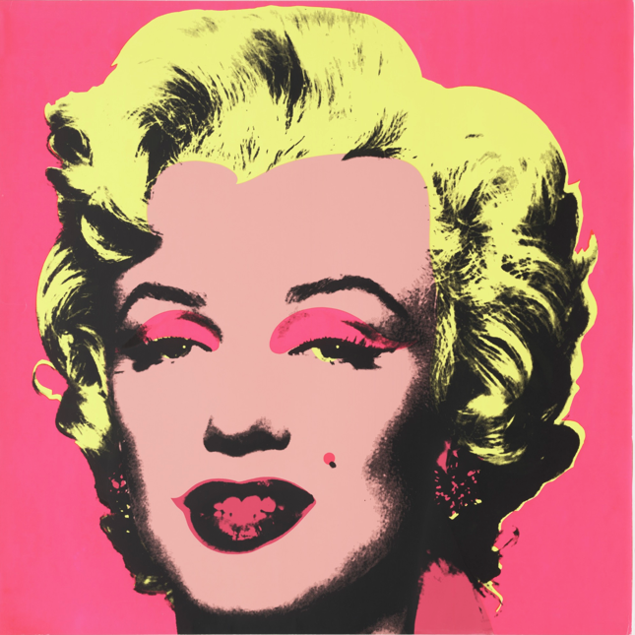
Mona Lisa Leonardo da Vinci 1503
Marilyn Monroe Andy Warhol 1967 Portfolio of 10 screenprints
Notes:
While we recognize her as a woman, and if you know who Marilyn Monroe was and know what she looked like, it’s very likely you would recognize this as her, even though she didn’t have bright pink eyelids or neon yellow hair. This is a different way of representing women than we’ve seen.
RESPONSE QUESTION 3/4: Compare and contrast these 2 paintings in a paragraph. Work off your description from response question 3.
RESPONSE QUESTION 4/4: Submit any questions you may have.

