Slide 1
Compare and contrast the given works of art in complete sentences. Use relevant art historical vocab and visual analysis to support your argument. You do not need to include everything you know about each work of art; select which information you include to best support your argument.

Slide 2
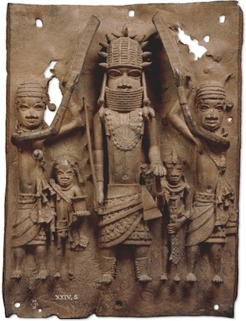
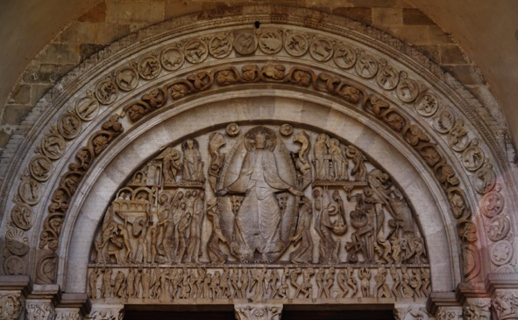
Brass Plaque Showing the Oba of Benin with Attendants 16th C 51 x 37 cm Edo Peoples, Benin, Nigeria
The Last Judgment St. Lazare Cathedral West Portal Gislebertus Autun, France c. 1130 CE

